Slide 1
Introduction to Linux Shell
Sandy Joseph
Department of CSE,
RSET
https://www.geeksforgeeks.org/introduction-linux-shell-shell-scripting/

Slide 2
In running Ubuntu, Linux Mint or any other Linux distribution, you are interacting to shell every time you use terminal.
In a Linux system we have
  Kernel
  Shell
  Terminal
The kernel is a computer program that is the core of a computer’s operating system, with complete control over everything in the system.
It manages following resources of the Linux system –
  File management
  Process management
  I/O management
  Memory management
  Device management etc.

Slide 3
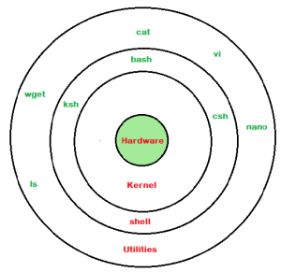
Shell
A shell is special user program which provide an interface to user to use operating system services.
Shell accept human readable commands from user and convert them into something which kernel can understand.
It is a command language interpreter that execute commands read from input devices such as keyboards or from files. The shell gets started when the user logs in or start the terminal.

Slide 4
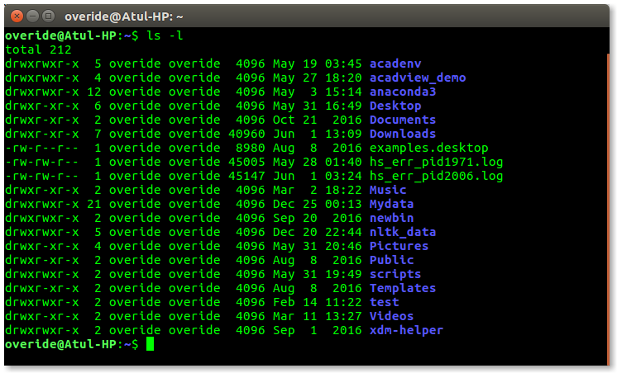
Shell is broadly classified into two categories
  Command Line Shell
  Graphical shell
Command Line Shell
Shell can be accessed by user using a command line interface.
A special program called Terminal in linux/macOS or Command Prompt in Windows OS is provided to type in the human readable commands such as “cat”, “ls” etc. and then it is being execute.
The result is then displayed on the terminal to the user.
A terminal in Ubuntu 16.4 system looks like this –

Slide 5
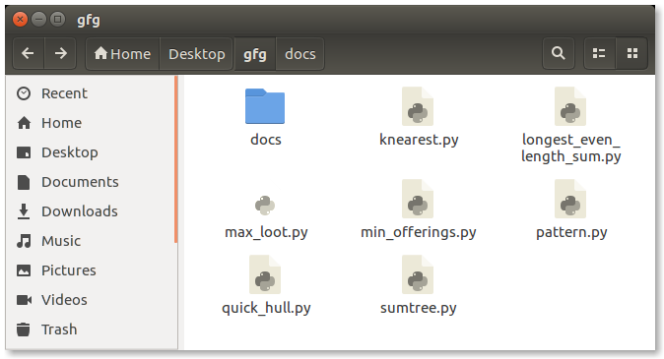
Graphical Shells
Window OS or Ubuntu OS can be considered as good example which provide GUI to user for interacting with program. User do not need to type in command for every actions. A typical GUI in Ubuntu system –

Slide 6
There are several shells are available for Linux systems like –
BASH (Bourne Again SHell) – It is most widely used shell in Linux systems. It is used as default login shell in Linux systems and in macOS. It can also be installed on Windows OS.
CSH (C SHell) – The C shell’s syntax and usage are very similar to the C programming language.
KSH (Korn SHell) – The Korn Shell also was the base for the POSIX Shell standard specifications etc.
Each shell does the same job but u

Slide 7
Shell Scripting
Usually shells are interactive that mean, they accept command as input from users and execute them.
However some time we want to execute a bunch of commands routinely, so we have type in all commands each time in terminal.
As shell can also take commands as input from file we can write these commands in a file and can execute them in shell to avoid this repetitive work.
These files are called Shell Scripts or Shell Programs.
Shell scripts are similar to the batch file in MS-DOS.
Each shell script is saved with .sh file extension eg. myscript.sh

Slide 8
A shell script comprises following elements –
  Shell Keywords – if, else, break etc.
  Shell commands – cd, ls, echo, pwd, touch etc.
  Functions
  Control flow – if..then..else, case and shell loops etc.

Slide 9
Need of shell scripts
To avoid repetitive work and automation.
System admins use shell scripting for routine backups.
System monitoring.
Adding new functionality to the shell etc.

Slide 10
Advantages of shell scripts
The command and syntax are exactly the same as those directly entered in command line, so programmer do not need to switch to entirely different syntax.
Writing shell scripts are much quicker.
Quick start.
Interactive debugging etc.

Slide 11
Disadvantages of shell scripts
Prone to costly errors, a single mistake can change the command which might be harmful.
Slow execution speed.
Design flaws within the language syntax or implementation.
Not well suited for large and complex task.
Provide minimal data structure unlike other scripting languages.

Slide 12
Syntax
A Shell provides you with an interface to the Unix system.
We are using Bourne Again shell (bash)
$ character is the default prompt.
Files are created as
  gedit filename.sh
  Eg:- gedit test.sh
  Before you add anything else to your script, you need to alert the system that a shell script is being started.
    This is done using the shebang construct.
    For example #!/bin/sh
    This is the first line of a shell program
  Running the program
    bash filename.sh

Slide 13
Variables
Variable Names
The name of a variable can contain only letters (a to z or A to Z), numbers ( 0 to 9) or the underscore character ( _).
By convention, Unix shell variables will have their names in UPPERCASE.
The following examples are valid variable names :-
  _ARUN
  TOKEN_A
  VAR_1
  VAR_2
  ITEM
  N
Read only variables- value can’t be changed
  readonly NAME
Arrays
  array_name[index]=value
  E:- NAMES[0]= “HARI”
  NAMES[1]=“ARUN”
  echo ${NAMES[0]}

Slide 14
Input and Output statement
Input statement
read variable_name
Eg:- read PERSON
read N
read ITEM
Assignment statement
variable_name = variable _value
Eg:- N=2
PERSON = rahul
Output statement
echo “message”
Eg:- echo “hello world”
echo $variable_name

Slide 15
Printing
Develop a shell script to display a message "Hello World".

Slide 16
#!/bin/bash
echo "Hello World"

Slide 17
Arithmetic operators
Relational operators
Logical operators
+ Addition
Subtraction
Multiplication
/ Division
% Modulus
= Assignment
++ increment
-- decrement
-eq equal to
-ne not equal to
-gt greater than
-lt less than
-ge greater than or equal to
-le less than or equal to
OR
== equal to
!= not equal to
> Greater than
>= greater than or equal to
< less than
<= less than or equal to
! logical negation
-o logical OR
-a logical AND
OR
! Logical negation
|| logical OR
&& logical AND

Slide 18
Computations
Develop a shell script to find the sum of two numbers.

Slide 19
#!/bin/bash
echo "Enter first number"
read n1
echo "Enter second number"
read n2
s=$((n1 + n2))
echo "Sum of $n1 and $n2 is $s"

Slide 20
Another method
#!/bin/bash
echo "Enter first number"
read n1
echo "Enter second number"
read n2
s=`expr $n1 + $n2`
echo "Sum of $n1 and $n2 is $s"

Slide 21
if else
if...fi statement
  if [ expression]
  then
  statements
  fi
if...else...fi statement
  if [ expression]
  then
  statements
  else
  statements
  fi
Develop a shell script to check if a number is odd or even.
if...elif...else...fi statement
if [expression 1]
then
Statements
elif[expression 2]
then
statements
elif[expression 3]
then
statements
else
statements
fi

Slide 22
#!/bin/bash
echo "Enter a number"
read n
r=$((n%2))
if [ $r -eq 0 ]
then
echo "$n is even"
else
echo "$n is odd"
fi

Slide 23
#!/bin/bash
echo "Enter a number"
read n
r=`expr $n % 2`
if [ $r -eq 0 ]
then
echo "$n is even"
else
echo "$n is odd"
fi

Slide 24
else if ladder
Develop a shell script to find the largest among two numbers

Slide 25
#!/bin/bash
echo "Enter first number"
read n1
echo "Enter second number"
read n2

Slide 26
if [ $n1 -gt $n2 ]
then
echo "$n1 is largest"
elif [ $n1 -lt $n2 ]
then
echo "$n2 is largest"
else
echo "Both numbers are equal"
fi

Slide 27
if elif elif else ladder
#!/bin/sh
a=10
b=20
if [ $a == $b ]
then
echo "a is equal to b"
elif [ $a -gt $b ]
then
echo "a is greater than b“
elif [ $a -lt $b ]
then
echo "a is less than b"
else echo "None of the condition met“
fi

Slide 28
Decision making
while loop
for loop
until loop
select loop
while [condition]
do
statements
done

Slide 29
for loop
Develop a shell script to print all the odd numbers less than n.

Slide 30
#!/bin/bash
echo "Enter limit"
read n
for(( i=1; i<n; i=i+2 ))
do
echo "$i"
done

Slide 31
while loop
Develop a shell script to print all the even number less than or equal to n.

Slide 32
#!/bin/bash
echo "Enter limit"
read n
i=2
while [ $i -le $n ]
do
echo "$i"
i=`expr $i + 2`
done

Slide 33
break
Develop a shell script to check if a number is prime or not.

Slide 34
#!/bin/bash
echo -n "Enter the number : "
read num
flag=0

Slide 35
for(( i=2; i<num; i++ ))
do
if [ $((num%i)) -eq 0 ]
then
flag=1
break
fi
done

Slide 36
if [ $flag -eq 0 ]
then
echo "$num is a prime number"
else
echo "$num is not a prime number"
fi

Slide 37
Develop a shell script to print all numbers from 1 to 100

Slide 38
#!/bin/bash
for(( i=1; i<=100; i++ ))
do
echo "$i"
done

Slide 39
Step 1: Start
Step 2: Write the shebang directive
Step 3: Initialise i = 1
Step 4: Repeat as long as i ≤ 100
Step 4.1: Print i
Step 4.2: Set i = i + 1
Step 5: Stop

Slide 40
nested for loops
Develop a shell script to print all the prime numbers between the given upper and lower limits.

Slide 41
arrays
Develop a shell script to perform linear search on an array.

Slide 42
#!/bin/bash
echo "Enter limit of array"
read n
echo "Enter elements in the array"
for(( i=0; i<n; i++ ))
do
read a[$i]
done
echo "Elements in the array are:"
for(( i=0; i<n; i++ ))
do
echo "${a[$i]}"
done
echo "Enter the element to be searched"
read element
flag=0

Slide 43
for(( i=0; i<n; i++ ))
do
if [ ${a[$i]} -eq $element ]
then
flag=1
break
fi
done
if [ $flag -eq 1 ]
then
echo "$ele is found"
else
echo "$ele is not found"
fi

Slide 44
Running shell script
Open file
gedit filename.sh
Running the script
bash filename.sh

Slide 45


